Slide 1
R.I.S.T: Radioulnar Instability Screening Tool
Group 24:
Saketh Balmoori
Kaitlyn Thornton
Chris Wissmann

Slide 2
Project Recap & Modifications

Slide 3
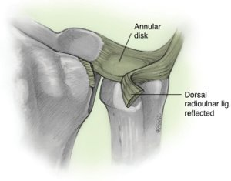
Project Recap
The Distal Radioulnar Joint (DRUJ) connects the radius and ulna at the wrist
Enables articulation of the radius around the ulna during pronation and supination¹
Instability can arise after distal radius fractures, which are common
Surgeries to resolve instability are well-established, but current diagnostic methods are purely qualitative
Creating a reliable, non-invasive diagnostic device would better inform surgical decision making and improve patient outcomes

Slide 4
Specification Updates
Device dimensions:
< 20 x 20 x 20 cm to < 40 x 40 x 40 cm
Adjustability ranges for the actuation mechanism:
Wrist thicknesses from 2-8 cm with a minimum of 1 cm of vertical clearance on either side
Palm rest is horizontally adjustable along the arm in a 15 cm range.
Medical Standards selected:
ISO 13485:2019 - Medical device quality management
ISO 14971:2016 - Medical device safety & risk management
ISO 9001:2015 - General device quality management

Slide 5
Design Options

Slide 6
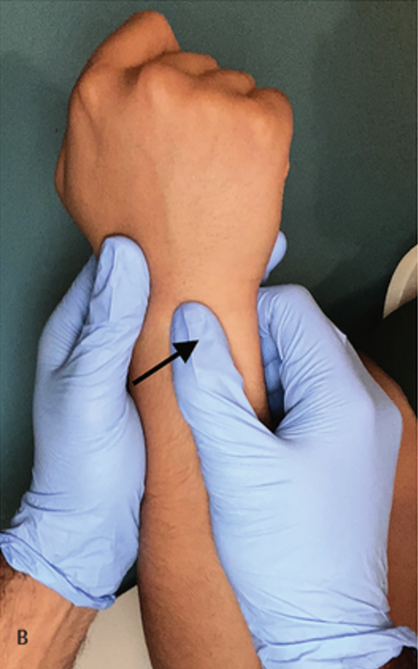
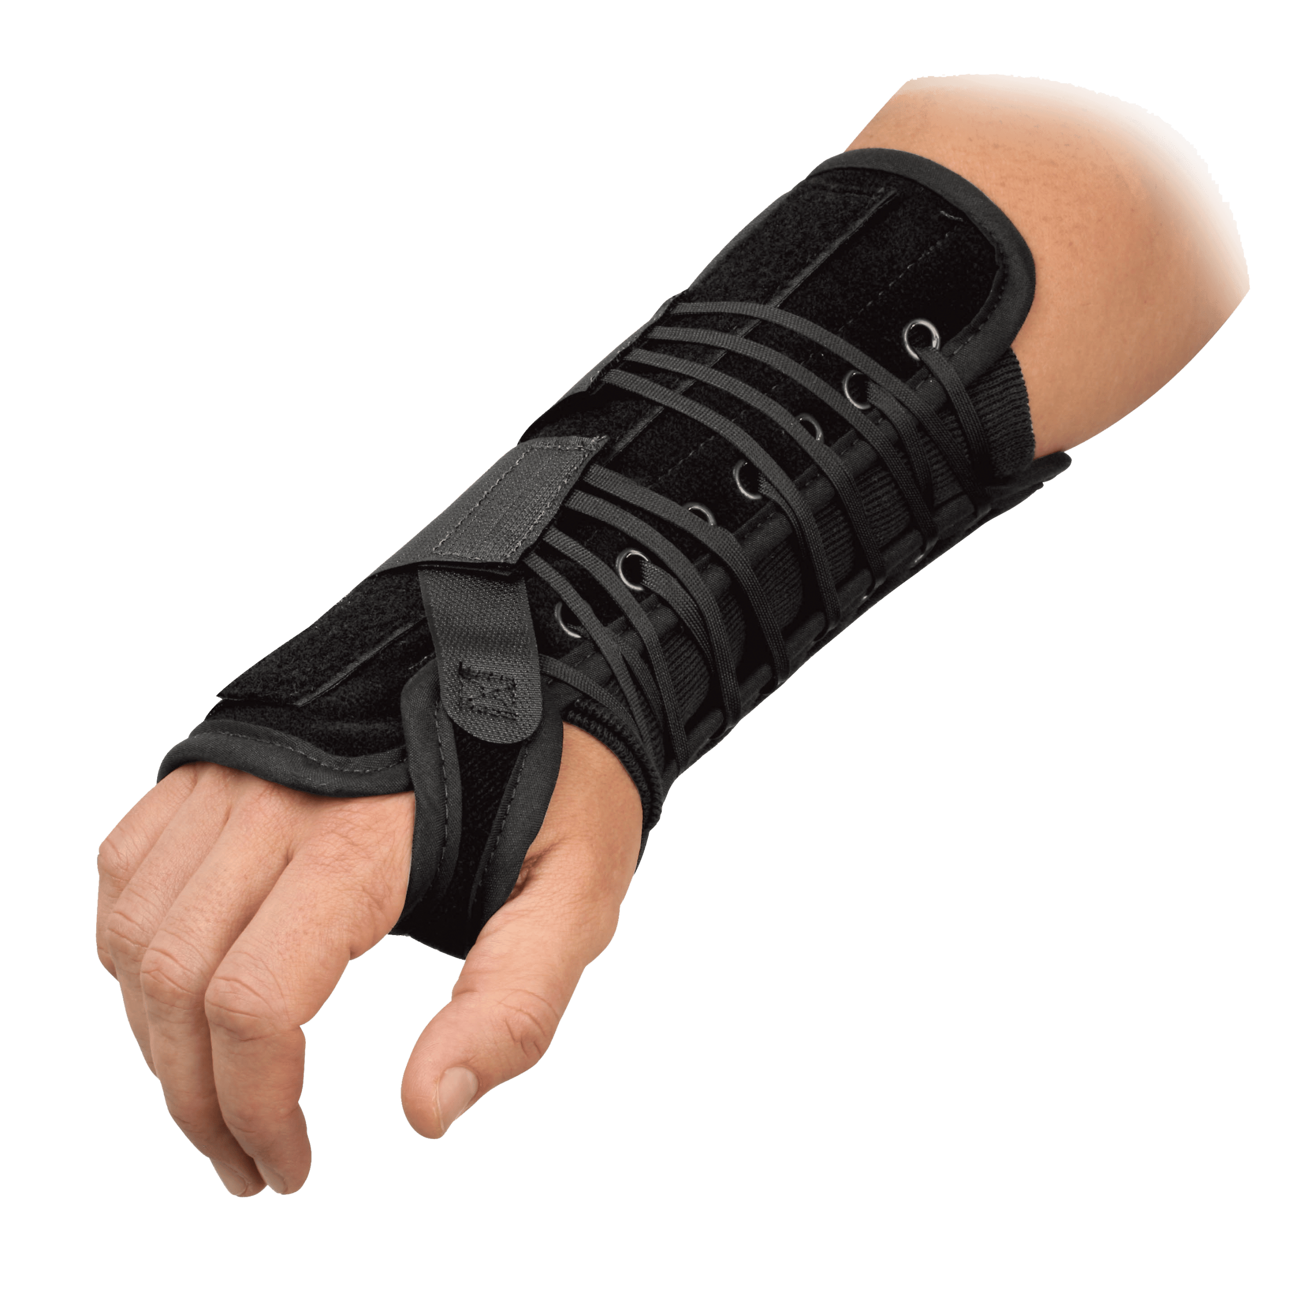
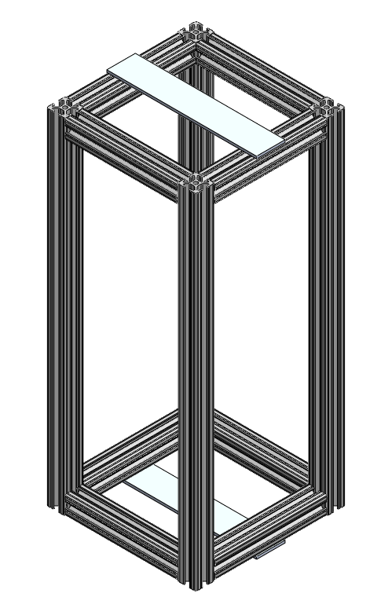
Main Rig
The following options were considered for the Main Rig of the device:
Gauntlet​
Heavy-duty limb brace
External Glove​
Examiner’s gloves with fingertip sensors
Box + Bracer
Limb brace combined with metal chassis
Box​
Standalone metal chassis
Notes:
Emphasize that this sub-category informed all subsequent ones very heavily

Slide 7
Main Rig - Analysis
Criteria | Weight | Gauntlet | External Glove | Box | Box + Bracer
Measurability | 10 | 3 | 3 | 8 | 8
Rigidity | 10 | 2 | 1 | 9 | 10
Adjustability | 9 | 2 | 10 | 9 | 6
Ejectability | 9 | 4 | 10 | 8 | 6
Complexity | 8 | 2 | 9 | 5 | 4
Comfort | 7 | 5 | 9 | 7 | 6
Cost | 7 | 4 | 1 | 8 | 7
Packaging | 7 | 8 | 10 | 6 | 3
Weight | 5 | 6 | 9 | 2 | 2
 | Total | 262 | 497 | 520 | 442
Selected Main Rig:​
Box
Notes:
Favorable outcomes being:
Catching more instances of DRUJ instability and intervening earlier
In turn – reduced risk of complications, restoration of patient abilities, etc.

Slide 8
Actuation Mechanism
The following options were considered for the Actuation Mechanism of the device:
Rotational Eccentric Cams
Set of four oblong cams
Linear Transducers
Set of four motorized pistons
Dual Clamp
Set of half-cuffs linked to two linear transducers

Slide 9
Actuation Mechanism​ - Analysis
Criteria | Weight | Rotational Cams | Linear Transducers | Dual Clamp
Data Acquisition | 10 | 3 | 8 | 2
Adjustability | 10 | 4 | 10 | 6
Contact Stability | 10 | 7 | 4 | 10
Safety | 9 | 7 | 9 | 4
Packaging Dimensions | 8 | 9 | 4 | 6
Dynamic Complexity | 8 | 5 | 8 | 3
Limb Positions | 7 | 10 | 8 | 8
Cost | 7 | 10 | 6 | 8
Total |  | 455 | 495 | 400
Selected Actuation Mechanism:​
Linear Transducers

Slide 10
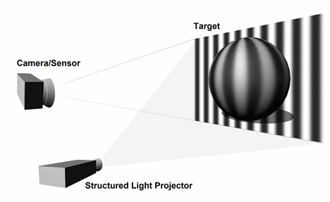
Translation Measurement (1/2)
The following options were considered for the Translation Measurement of the device:
Ultrasound
An axial cross section of the wrist determining translation via ultrasound, which is shown in previous literature to be extremely accurate
Cuff-Mounted Laser Reflector/Hall Effect
Vertical striped measurement guide attached to wrist cuff that reflects a laser onto light sensor/activates Hall Effect
Structured Light
Coupled projective light source and 3D vision scanning system to map shape & depth changes
Notes:
Talk about STA first

Slide 11
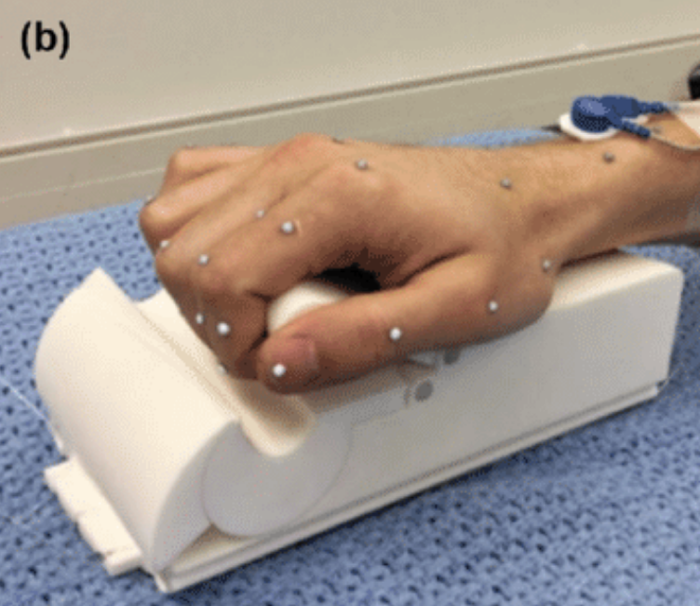
Translation Measurement (2/2)
The following options were considered for the Translation Measurement of the device:
IR Markers
IR Markers adhered to wrist using boney landmarks on patient's wrist during translation
Software Rigidification
Software recalculation that takes displacement data and accounts for soft tissue artifacts, can be combined with previous technologies
Actuator Translation Tracking (ATT)
Back-End internal measurement from software that takes actuator data input or alternate sensing modality to determine bone displacement

Slide 12
Translation Measurement - Analysis
Criteria | Weight
Accuracy | 10 | 9 | 2 | 4 | 7 | 6 | 9 | 6
Feedback Delay | 10 | 9 | 5 | 5 | 2 | 8 | 4 | 9
Hardware Complexity | 9 | 8 | 8 | 8 | 3 | 7 | 4 | 8
Patient Prep Time | 9 | 3 | 6 | 6 | 10 | 4 | 10 | 10
Cost | 7 | 1 | 6 | 6 | 2 | 8 | 3 | 10
Sampling Rate | 7 | 10 | 7 | 7 | 3 | 9 | 3 | 8
Software Complexity | 6 | 7 | 9 | 9 | 2 | 7 | 2 | 9
Computational Reqs. | 5 | 4 | 9 | 9 | 2 | 6 | 3 | 9
Power Reqs. | 4 | 5 | 8 | 8 | 4 | 7 | 3 | 8
Total |  | 418 | 386 | 406 | 264 | 430 | 325 | 537
Optical Bracer
Software Rigid.
Hall-Effect Bracer
Structured Light
Ultrasound
IR Markers
ATT
Selected Translation Measurement:​
ATT

Slide 13
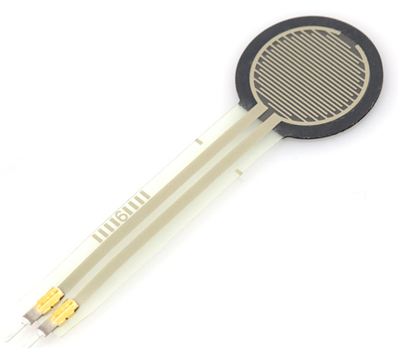
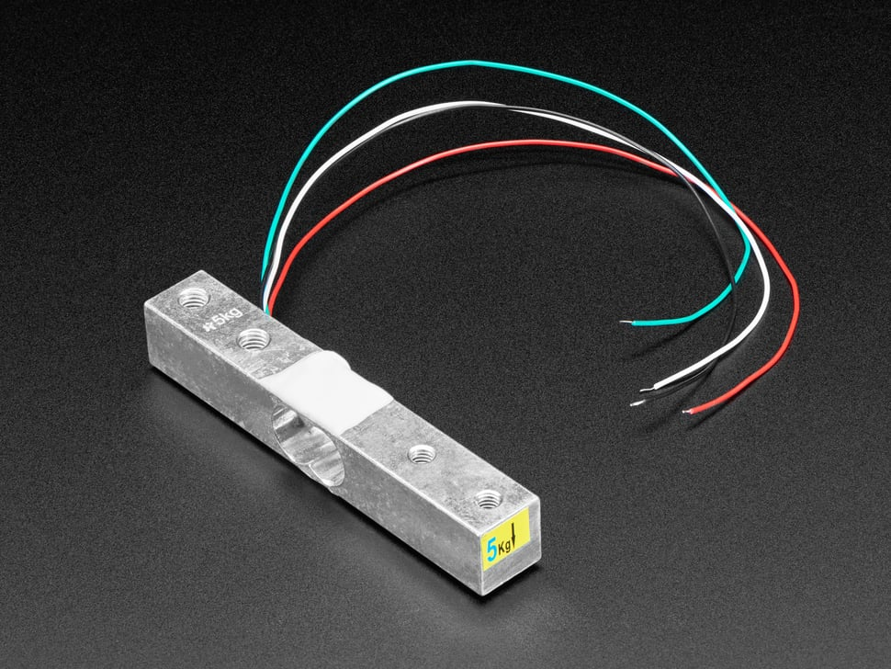
Force Measurement
The following options were considered for the Force Measurement of the device:
Force Resistive Sensors
Contact sensors placed on actuator surfaces
Strain Gauge Load Cell
Mechanisms that sit between actuators and direct point of contact and measure strain
Electrical Current Back-Calculation
Back calculating the input current and power with the given torque value of a transducer or motor can give an accurate indication of force applied

Slide 14
Force Measurement - Analysis
Criteria | Weight | Load Cell | Force Resistive Sensor | Current Back-Calculation
Accuracy | 10 | 10 | 8 | 6
Feedback Delay | 10 | 10 | 7 | 6
Hardware Complexity | 9 | 7 | 8 | 10
Cost | 7 | 4 | 9 | 10
Sampling Rate | 7 | 10 | 8 | 9
Packaging Dimensions | 7 | 4 | 9 | 10
Software Complexity | 6 | 9 | 8 | 5
Computational Reqs. | 5 | 8 | 9 | 7
Total |  | 483 | 497 | 478
Selected Force Measurement:​
Force Resistive Sensor

Slide 15
Chosen Design

Slide 16
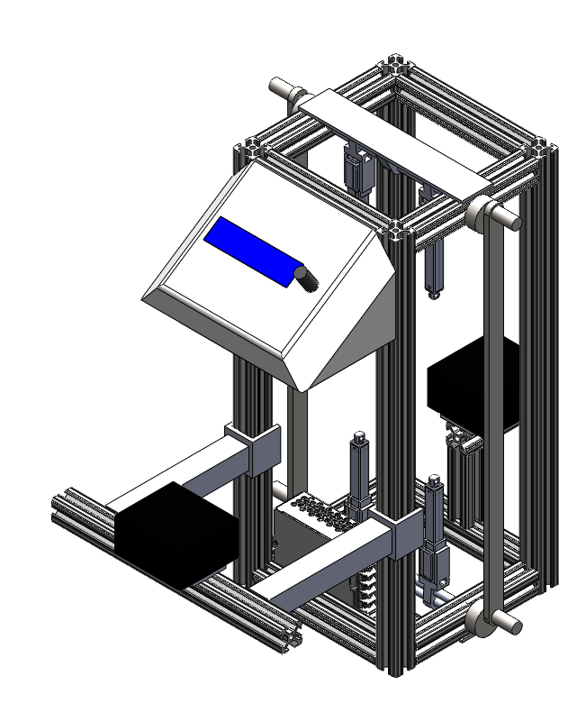
Chosen Combination
Chassis/Box
Linear Transducers
ATT
Force Resistive Sensors
Notes:
FDA Center for Devices and Radiologic Health
American Society of Testing and Materials
Consult guidelines/requirements/specifications laid out by these regulatory bodies
Drs. Goldfarb and Wright are most important
- Dr. Wright developed one of the first methods of quantitative DRUJ assessment
Both have spearheaded the discussion about the need for DRUJ quantification within the field
Medical device companies will eventually take our concept to market, but don’t have much influence over our design during development
OT’s and prospective patients will be consulted to ensure device is comfortable/as painless as possible
Other hand surgeons will eventually use the device, but aren’t necessarily as invested as Goldfarb/Wright
Nonclinical ortho personnel will be exposed to the device once it hits the market, so they need to be aware of it

Slide 17
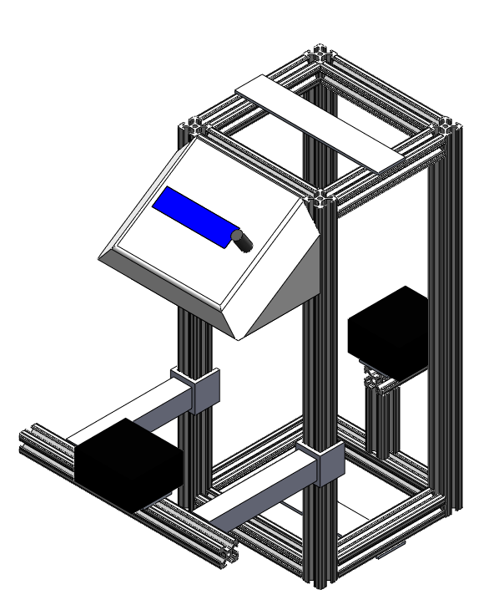
Chosen Combination
Chassis/Box
Linear Transducers
ATT
Force Resistive Sensors
Notes:
FDA Center for Devices and Radiologic Health
American Society of Testing and Materials
Consult guidelines/requirements/specifications laid out by these regulatory bodies
Drs. Goldfarb and Wright are most important
- Dr. Wright developed one of the first methods of quantitative DRUJ assessment
Both have spearheaded the discussion about the need for DRUJ quantification within the field
Medical device companies will eventually take our concept to market, but don’t have much influence over our design during development
OT’s and prospective patients will be consulted to ensure device is comfortable/as painless as possible
Other hand surgeons will eventually use the device, but aren’t necessarily as invested as Goldfarb/Wright
Nonclinical ortho personnel will be exposed to the device once it hits the market, so they need to be aware of it

Slide 18
Chosen Combination
Chassis/Box
Linear Transducers
ATT
Force Resistive Sensors
Notes:
FDA Center for Devices and Radiologic Health
American Society of Testing and Materials
Consult guidelines/requirements/specifications laid out by these regulatory bodies
Drs. Goldfarb and Wright are most important
- Dr. Wright developed one of the first methods of quantitative DRUJ assessment
Both have spearheaded the discussion about the need for DRUJ quantification within the field
Medical device companies will eventually take our concept to market, but don’t have much influence over our design during development
OT’s and prospective patients will be consulted to ensure device is comfortable/as painless as possible
Other hand surgeons will eventually use the device, but aren’t necessarily as invested as Goldfarb/Wright
Nonclinical ortho personnel will be exposed to the device once it hits the market, so they need to be aware of it

Slide 19
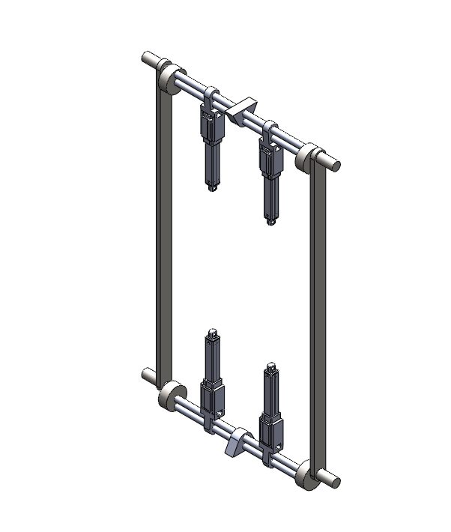
Chosen Combination
Chassis/Box
Linear Transducers
ATT
Force Resistive Sensors
Notes:
FDA Center for Devices and Radiologic Health
American Society of Testing and Materials
Consult guidelines/requirements/specifications laid out by these regulatory bodies
Drs. Goldfarb and Wright are most important
- Dr. Wright developed one of the first methods of quantitative DRUJ assessment
Both have spearheaded the discussion about the need for DRUJ quantification within the field
Medical device companies will eventually take our concept to market, but don’t have much influence over our design during development
OT’s and prospective patients will be consulted to ensure device is comfortable/as painless as possible
Other hand surgeons will eventually use the device, but aren’t necessarily as invested as Goldfarb/Wright
Nonclinical ortho personnel will be exposed to the device once it hits the market, so they need to be aware of it

Slide 20
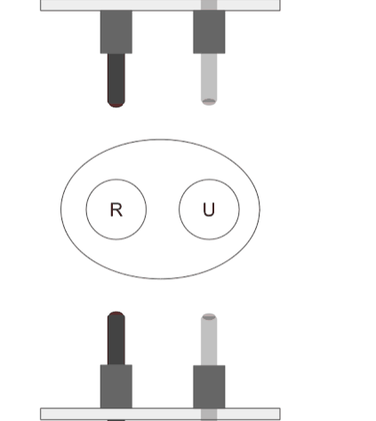
Chosen Combination
Chassis/Box
Linear Transducers
ATT
Force Resistive Sensors
Notes:
FDA Center for Devices and Radiologic Health
American Society of Testing and Materials
Consult guidelines/requirements/specifications laid out by these regulatory bodies
Drs. Goldfarb and Wright are most important
- Dr. Wright developed one of the first methods of quantitative DRUJ assessment
Both have spearheaded the discussion about the need for DRUJ quantification within the field
Medical device companies will eventually take our concept to market, but don’t have much influence over our design during development
OT’s and prospective patients will be consulted to ensure device is comfortable/as painless as possible
Other hand surgeons will eventually use the device, but aren’t necessarily as invested as Goldfarb/Wright
Nonclinical ortho personnel will be exposed to the device once it hits the market, so they need to be aware of it

Slide 21
Chosen Combination
Chassis/Box
Linear Transducers
ATT
Force Resistive Sensors
Notes:
FDA Center for Devices and Radiologic Health
American Society of Testing and Materials
Consult guidelines/requirements/specifications laid out by these regulatory bodies
Drs. Goldfarb and Wright are most important
- Dr. Wright developed one of the first methods of quantitative DRUJ assessment
Both have spearheaded the discussion about the need for DRUJ quantification within the field
Medical device companies will eventually take our concept to market, but don’t have much influence over our design during development
OT’s and prospective patients will be consulted to ensure device is comfortable/as painless as possible
Other hand surgeons will eventually use the device, but aren’t necessarily as invested as Goldfarb/Wright
Nonclinical ortho personnel will be exposed to the device once it hits the market, so they need to be aware of it

Slide 22
Proposed Budget

Slide 23
Budget Breakdown
Item | Qty | Unit Cost | Item Subtotal
HiTec 50 mm linear servo actuator | 4 | $99.99 | $399.96
6-channel servo controller | 1 | $24.95 | $24.95
Force resistive sensor | 4 | $4.95 | $19.80
Arduino Uno | 1 | $31.74 | $31.74
Black anodized extruded aluminum bars | 5 | $21.15 | $105.75
Prusa LCD unit | 1 | $56.72 | $56.72
12V 5A PSU | 1 | $24.95 | $24.95
Lead screws | 4 | $14.97 | $59.88
Linear motion rods | 8 | $9.99 | $79.92
Telescopic tubing locks | 6 | $6.00 | $36.00
Square aluminum telescopic tubing, 1" | 3 | $8.92 | $26.76
Square aluminum telescopic tubing, 0.875" | 3 | $8.41 | $25.23
Hardware, Filament, Wiring, Consumables | N/A |  | $100.00
Actuation = $424.91 Translation Measurement = $19.80 Chassis = $333.54 Electronics = $133.41 Misc. = $100 |  | Total | $961.68

Slide 24
Thank You!
Questions?

Slide 25
Appendix

Slide 26
Design Specifications
Category | Sub-Category | Specification
Performance | Sensitivity | <0.5 mm joint displacement
 | Force Application | customizable, 0-20 N range with 0.25 N resolution
 | Force Application Lag Time | Input-to-actuation lag time of <1 s
 | Software Sampling Rate | >100 samples/sec
 | Software Lag Time | Real-time force and translation output
Accessibility & Ergonomics | Testing Setup Comfort | Arm setup in chassis is comfortable for extended testing periods (>10 min)
 | Hand/Palm Rest | Adjustable horizontal (along arm) range of 15 cm.
 | Limb Zone | Adjustable testing zone diameter of 10-25 cm
 | Rig Chirality | Ambidextrous, capable of force application on dorsal and ventral sides of both wrists
Safety & Compliance | Device Material | Hypoallergenic
 | Device Cleaning | Sanitizable in <10 min
 | Arm Removal | Limb removal in <15 s in event of emergency
 | Physical Emergency System | Manual shut-off switch in event of patient discomfort
 | Software Emergency System | Software shut-off switch in event of wrist displacement exceeding 4.81 cm of translation
 | Regulatory Standards | ISO 13485:2019, ISO 14971:2016, and ISO 9001:2015 compliant

Slide 27
Design Specifications (continued)
Category | Sub-Category | Specification
Technical Design | Sensor Implementation | Non-invasive
 | Sensor Variability | Calibratable for wrist thicknesses within 2-8 cm
 | Mechanical Isolation | Chassis vibrationally isolated from ambient, <0.1 mm of chassis movement
 | Electrical Isolation | Chassis grounded and patient electrically isolated
 | Device Dimensions | < 40 x 40 x 40 cm
 | Arm Mounting System | Two-point mounting, arm must remain entirely static prior to force application
UI & Operation | Operational Regulations | Easy operation, learning period <1 hr
 | Display | Simple digital display for real-time force/translation readout
 | Interactive Operability | Large, tactile buttons, dials, and/or switches
 | Data Output | universally recognized by any modern computer
Prototype Development Cost |  | <$1000

Slide 28
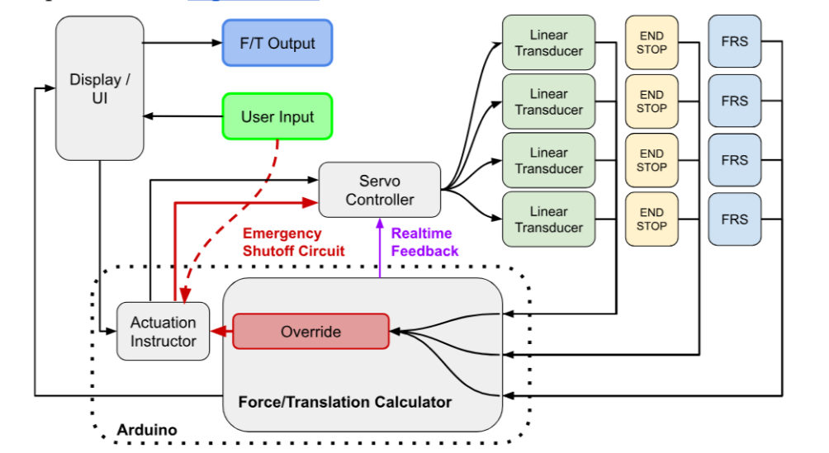
Control Scheme Block Diagram

Slide 29
Testing Scheme Overview

Slide 30
Basic Control Pseudocode

