Slide 1
DRUJ-Instability Quantification Rig
Group 24:
Saketh Balmoori
Kaitlyn Thornton
Chris Wissmann

Slide 2
Background

Slide 3
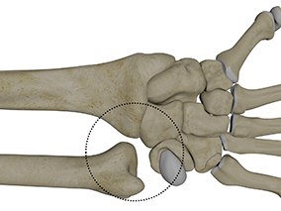
What is the DRUJ?
The Distal Radioulnar Joint (DRUJ) connects the radius and ulna at the wrist
Responsible for stabilizing articulation of the radius around the ulna during pronation and supination¹
Triangular Fibrocartilage Complex (TFCC) injuries are a leading cause of DRUJ instability²
1. Black, Varacallo. Statpearls, 2024
2. Allen. Orthobullets
Notes:
Distal Radioulnar Joint (DRUJ) is key wrist articulation and stabilization point
Triangular Fibrocartilage Complex (TFCC) highly responsible for stability

Slide 4
Population
10-20% incidence rate of DRUJ instability following distal radius fractures
25% of upper extremity fractures in the US³
Symptoms: pain, diminished grip strength
Complications: arthritis, persistent weakness, gross instability²
2. Allen. Orthobullets
3. Corsino, Reeves, Seig. Statpearls, 2023
Notes:
10-20% incidence rate following distal radius fractures (25% of upper extremity fractures in the US)
Patient Impacts: Chronic and acute pain, diminished grip strength, arthritis, gross instability

Slide 5
Market
Surgeries to resolve DRUJ instability are well established⁴
DRUJ instability commonly overlooked (up to 50% of cases)⁵
No devices capable of DRUJ instability quantification currently exist on the market
Creating a reliable, non-invasive device would better inform surgical decision making and improve patient outcomes
4. Rodríguez-Merchán, Shojaie. Archives of bone and joint surgery, 2022
5. Stevens, Cadogan. LITFL, 2023
Notes:
DRUJ instability commonly overlooked and misdiagnosed
Gold standard of testing is wholly qualitative

Slide 6
Our Clients
Dr. Charles Goldfarb
Hand and wrist surgeon at WashU Medicine
Dr. David Wright
Hand and wrist surgeon at UC Irvine

Slide 7
Need Statement + Project Scope

Slide 8
Need Statement
“
When orthopedic hand surgeons attempt to understand distal radioulnar joint instability, there is a need to efficiently and practically quantify joint stability to succinctly inform surgical decision-making for more favorable outcomes.
”
Notes:
Favorable outcomes being:
Catching more instances of DRUJ instability and intervening earlier
In turn – reduced risk of complications, restoration of patient abilities, etc.

Slide 9
Project Scope
Diagnosis of instability in the distal radioulnar joint is limited to a qualitative judgment of "stable" or "unstable;" efficient, practical assessment of distal radioulnar joint stability currently remains out of reach. Presently, qualitative wrist ballottement tests are used to elicit doctor opinion and patient pain response to determine structural instability. A rig involving drilling into the arm bones of cadavers to mount electromagnetic tracking sensors and a Microscribe transducer was used as an invasive, yet accurate method of sub-millimeter instability quantification. With a similarly capable portable, noninvasive, and comfortable device, surgeons could better judge the surgical methodology required for an individual patient and reliably determine post-operative efficacy.
We intend to develop a non-invasive system to gauge joint instability by February 2025 and deliver a final prototype to Dr. Goldfarb by April 20th, 2025, so that his surgical team can gauge the system's accuracy and reliability in a clinical setting. Alongside prototype delivery, we will provide manufacturing plans and relevant design files needed to reproduce the rig in the event of success.
Notes:
Re-emphasize that there is available quantitative method for DRUJ assessment
We need to create a device that is:
Capable of assessing translation to <1mm
Practical to use: portable, noninvasive, comfortable
Develop a system to accurately quantify druj translation by Feb. 2025
Packaged, complete prototype device delivered by April 2025

Slide 10
Stakeholders

Slide 11
FDA-CDRH
ASTM
Dr. Goldfarb
Dr. Wright
Stakeholder Influence
Other hand Surgeons
Non-clinical ortho personnel
Medical device companies
Occupational therapists
Prospective patients
Stakeholder Interest
Notes:
FDA Center for Devices and Radiologic Health
American Society of Testing and Materials
Consult guidelines/requirements/specifications laid out by these regulatory bodies
Drs. Goldfarb and Wright are most important
- Dr. Wright developed one of the first methods of quantitative DRUJ assessment
Both have spearheaded the discussion about the need for DRUJ quantification within the field
Medical device companies will eventually take our concept to market, but don’t have much influence over our design during development
OT’s and prospective patients will be consulted to ensure device is comfortable/as painless as possible
Other hand surgeons will eventually use the device, but aren’t necessarily as invested as Goldfarb/Wright
Nonclinical ortho personnel will be exposed to the device once it hits the market, so they need to be aware of it

Slide 12
Design Specifications

Slide 13
Category | Specification
Sensitivity | < 0.5 mm joint displacement
Testing Setup Comfort | adjustable resting height accommodate varying wrist sizes
Sensor Implementation | Non-invasive epicutaneous accurate for multiple wrist diameters
Isolation | Vibrationally isolated (<0.1mm) Electrically isolated
Dimensions | < 20 cm x 20 cm x 20 cm
Data Output | Universal: .csv or .txt filetype
Operation Regulations | Easily operated with low learning curve Tactile buttons, clean interface Large, readable display

Slide 14
Category (continued) | Specification (continued)
Safety | Hypoallergenic, sanitizable Repeatable tests without patient injury Easy to remove hand physical + software shut-off switches
Applicable Force Input + Range | Granular and customizable: 0-20 N with 0.25 N resolution input-to-actuation lag time of <1 sec
Mounting System | Static/acute mounting for forearm to completely prevent unwanted rotation
Sampling Rate | 100 samples/sec Real-time force/translation readout
Rig Chirality | Ambidextrous Dorsal and volar force application
Cost | < $1000

Slide 15
Existing Solutions

Slide 16
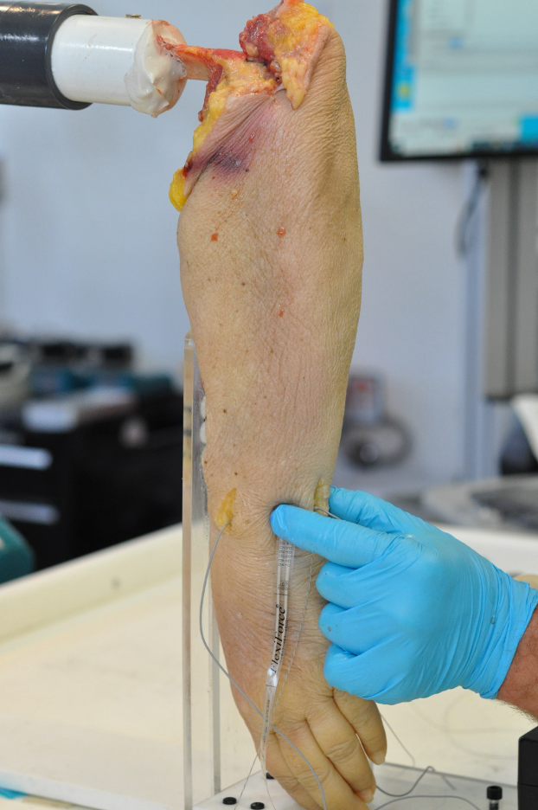
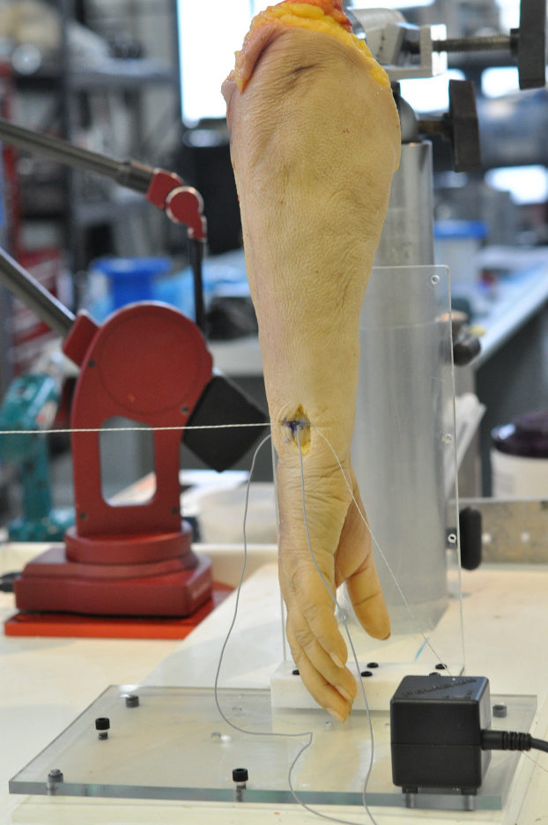
Invasive Cadaver Rig
Accurate to <1mm
Invasive
Delicate
Expensive
Notes:
irst existing solution is a testing stand/rig
Developed by Dr. Wright and Dr. Goldfarb
Utilizes electromagnetic tracking sensors embedded into radius and ulna to measure translation
Force transducer was used to apply known dorsal/volar loads to the ulna
Pros: accurate to <1mm, measures both force and translation; does "what we need"
Cons:
invasive - sensors were placed inside of the bones
delicate - EM sensors highly susceptible to interference, no ferromagnetic materials
expensive - particular EM sensor system used is >$8,000, force transducer ~$2,000
Conclusions: decent "first step" towards a usable device, but isn't practical - cost alone would likely make it unmarketable

Slide 17
Ballottement test
Convenient
Qualitative
64% sensitivity, 44% specificity⁶
6. P. LaStayo, J. Howell, Journal of hand therapy, 1995
7. CRTechnologies, YouTube, 2011
Notes:
next solution is the DRUJ ballottement test
this is the gold standard of assessment methods used clinically today
examiner grabs radius, wiggles ulna up/down or vice versa - compares "felt" movement to other hand, patient pain
Biggest issue with ballottement test is subjectivity - nothing is actually measured
general consensus is that it's not great
considered to be "unreliable"
Journal of Hand therapy placed the sensitivity of the test at 64%, and the specificity at 44%
at best, it leads to additional testing like MRI or CT, at worst the instability goes undiagnosed or leads to unnecessary surgical intervention

Slide 18
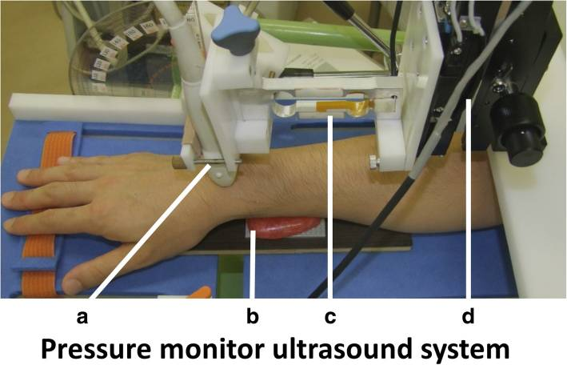
Ultrasound Quantification Rig
Non-invasive
Accurate to 0.01 mm⁸
82% sensitivity, 86% specificity⁹
Expensive
Single arm position
Difficult to operate
(transducer)
(wrist rest)
(pressure sensor + strain gauge)
(actuating motor)
8. Ishii, Yoshi et. al. Journal of orthopaedic surgery and research, 2019
9. Ishii, Shiraishi et. al. Ultrasound, 2022
Notes:
it uses a transducer (a) pressing against the distal ulna which rests on a block (b). Pressure and strain gauge sensors (c) determine transducer output, and the system is driven by an actuating motor (d)
Ultrasound measures compression between radius and ulna to determine translation
Pros:
very accurate - additional sig-fig precision than Dr. Wright's rig
non-invasive, preliminary follow-up data for spec/sens (one patient only, so kinda limited)
Cons:
expensive (ultrasound device used is ~$13k)
developed for single arm position only (pronation, no neutral or supination)
complicated to operate -> means hand surgeons/ortho people would need extensive training to operate
reliability issues

Slide 19
Design Schedule + Team Responsibilities

Slide 20
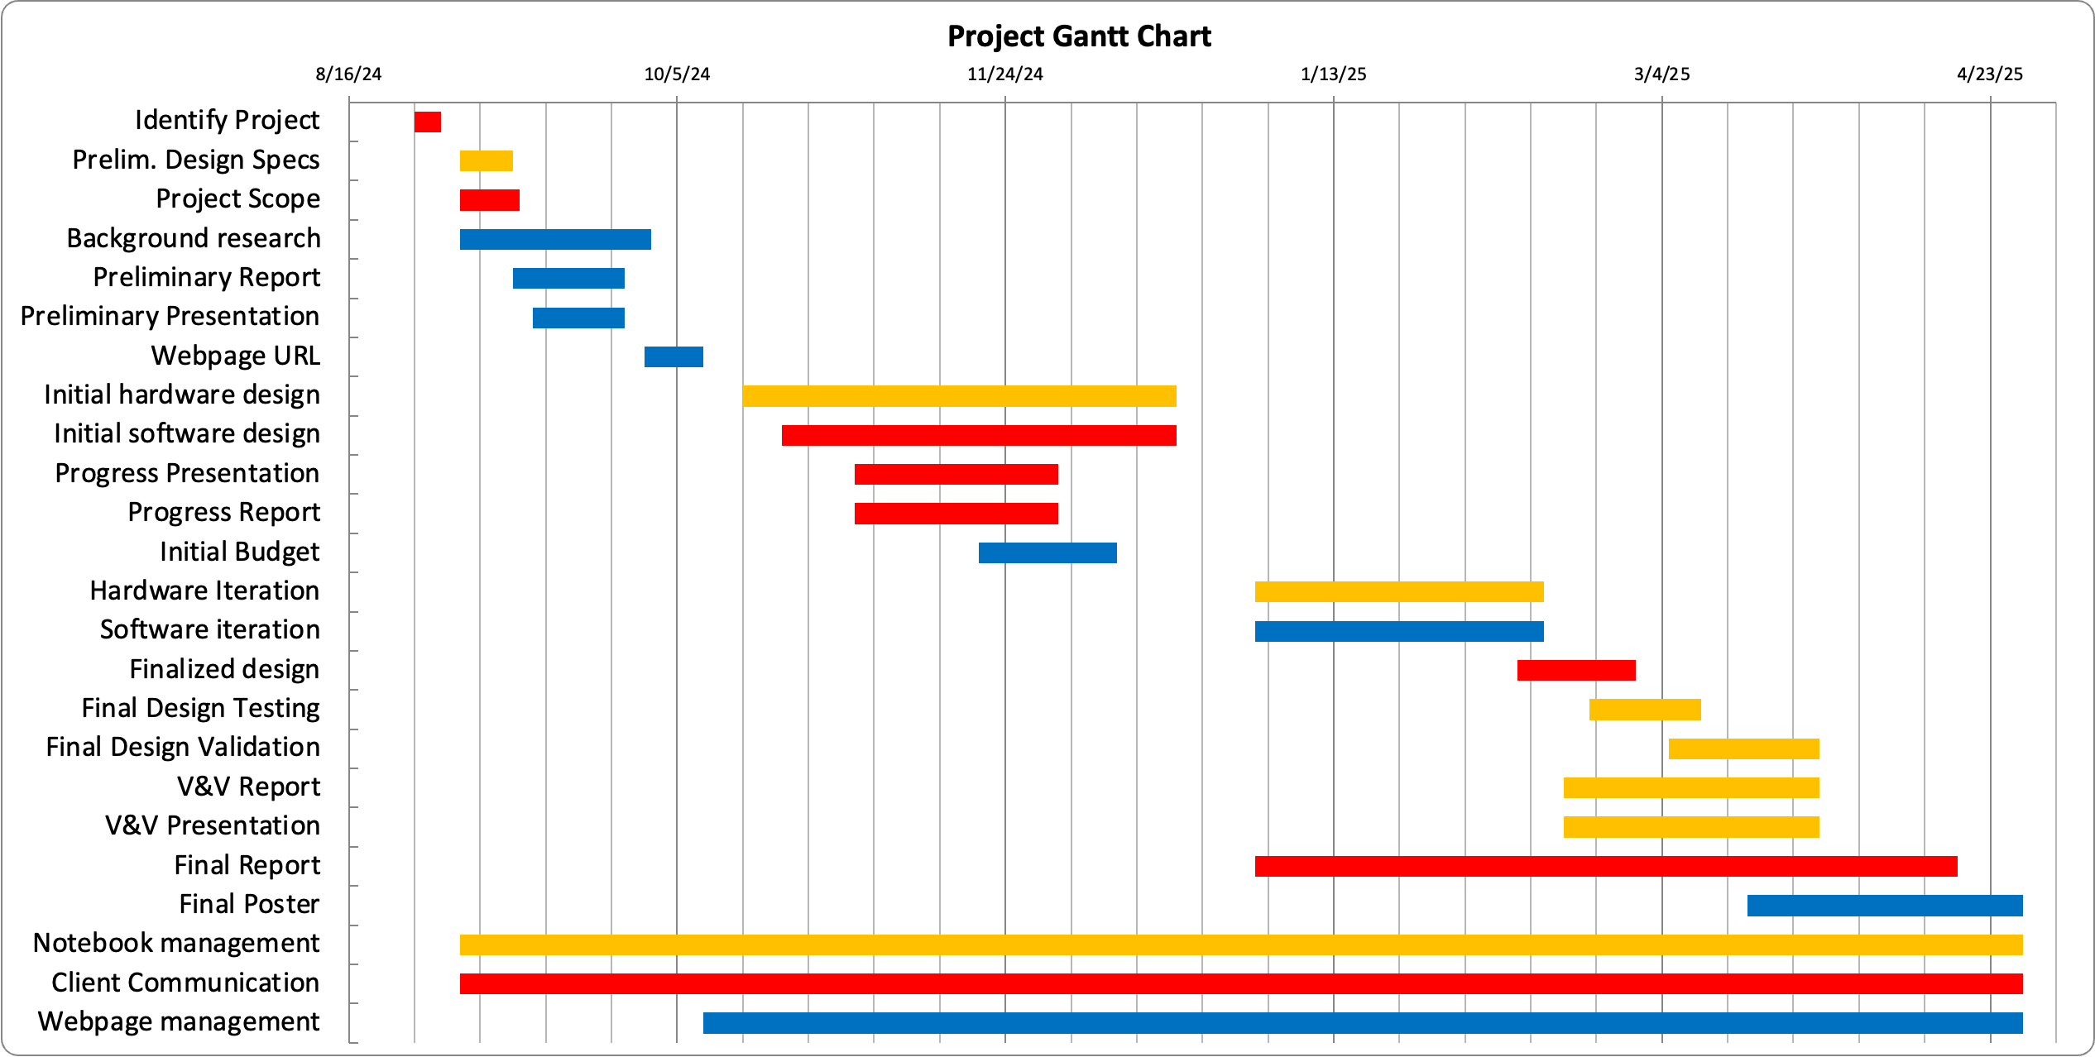
Design Schedule
Saketh Kaitlyn Chris

Slide 21
Team Responsibilities
Member | Responsibilities
Saketh Balmoori | Primary notebook manager CAD, mechanical testing V&V Presentation
Kaitlyn Thornton | Primary client liaison Sensor and device integration Progress Presentation
Chris Wissmann | Primary research lead Software development, website manager Preliminary Presentation

Slide 22
Thank You!
Questions?

